Slide 1
Macromolecule

Slide 2
Organic Compounds
contain carbon; examples include lipids, proteins, and carbs
(carbohydrates) . NCHOPS

Slide 3
Functional groups
amino (NH2),
carbonyl (RCOR),
carboxyl (COOH)
hydroxyl (OH),
phosphate (P04)
sulfhydryl (SH)

Slide 4
Fats
Used for protection, energy, signaling, protection, contain C₆H₁₂O₁
glycerol + 3 fatty acids.

Slide 5
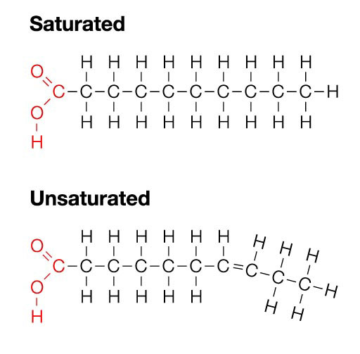
Saturated Fat
animals and some plants have it; solidifies" at room temperature. No double bonds

Slide 6
Unsaturated fat:
plants have it; liquefies at room temperature. Contains double bonds along carbon chain.

Slide 7
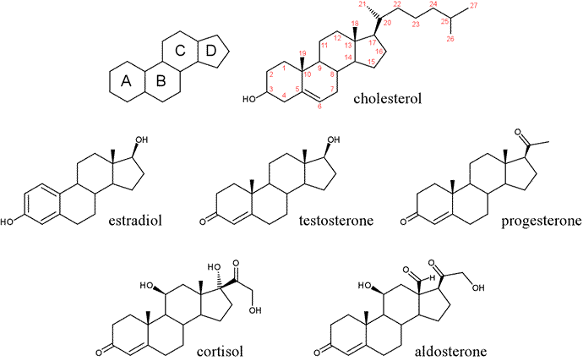
Steroids:
lipids whose structures resemble chicken-wire fence; include cholesterol and sex hormones.

Slide 8
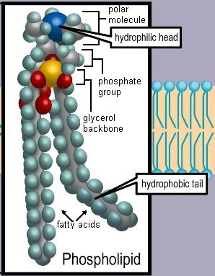
Phospholipids:
glycerol + 2 fatty acids + 1 phosphate group; make up membrane bilayers of cells; have hydrophobic interiors and hydrophilic exteriors.

Slide 9
Carbohydrates:
used by cells for energy and structure; monosaccharides (glucose), disaccharides (sucrose, maltose, lactose),
storage polysaccharides (starch [plants], glycogen [animals]),
structural polysaccharides (chitin [fungi], cellulose [arthropods]).

Slide 10
Proteins:
made with the help of ribosomes out of a sequence amino acids; serve many functions (e.g., transport, enzymes, cell signals, receptor molecules, structural components, and channels).

Slide 11
Enzymes:
catalytic proteins that react in an induced-fit fashion with substrates to speed up the rate of reactions by lowering the activation energy; (lock and key)
affected by changes in pH, temperature, and substrate and enzyme concentrations.

Slide 13
Competitive inhibition:
inhibitor resembles substrate and binds to active

Slide 15
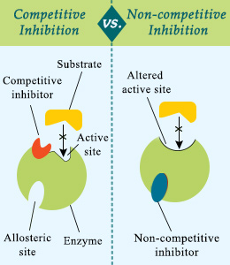
Noncompetitive inhibition:
inhibitor binds elsewhere on enzyme; alters active site so that substrate cannot bind.

Slide 16
pH:
logarithmic scale <7 acidic, 7 neutral, >7 basic (alkaline); pH 4 is 10 times more acidic than pH 5.
Base = concentration of OH- ions
Acid= concentration of H+

Slide 18
Reaction types:
Hydrolysis reaction: breaks down compounds by adding water.
-cut with water
Dehydration synthesis reaction: two components brought together, producing H20.
Endergonic reaction: reaction that requires input of energy. (enter)
Exergonic reaction: reaction that gives off energy. (exit)

